Slide 1
Facial Expression Recognition
CS 9840 Machine Learning in Computer Vision
Project presentation
Qijie Chen
Jan 20th 2016

Slide 2
Agenda
Overview
Data Source
Feature Extraction
Data Reduction
Classifier Selection
Test Result
Summary

Slide 3
Overview
The target of this project is using machine learning technique to find an approach to recognize and classify human facial expression
Workflow:
Data Source
Preprocessing
Feature Extraction
Test and Analysis
Classifier Creation
Data Reduction

Slide 4
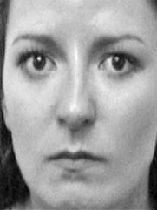
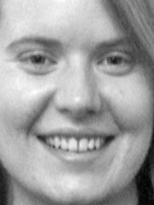
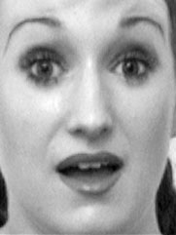
Data Source
Pain Expression Subset_{(Link)} :pictures with 7 expressions(angry, depressed, frightened, happy, normal, painful and surprised) from each of 12 women
e.g.
75% for training(9 pics/expression),25% for testing(3 pics/expression)
Angry
Happy
Surprised

Slide 5
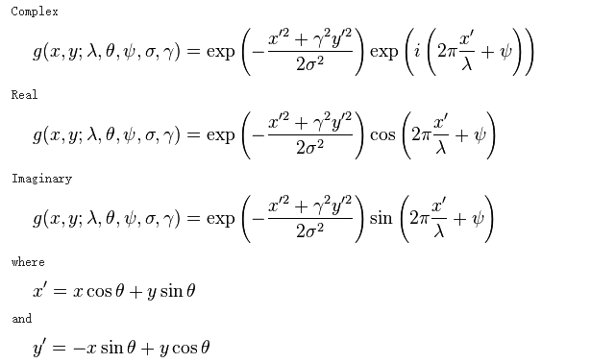
Feature Extraction
Gabor Filter: A linear filter used for edge detection. Frequency and orientation representations of Gabor filters are similar to those of the human visual system. It is found to be appropriate for texture representation and discrimination
General definition of Gabor Filter

Slide 6
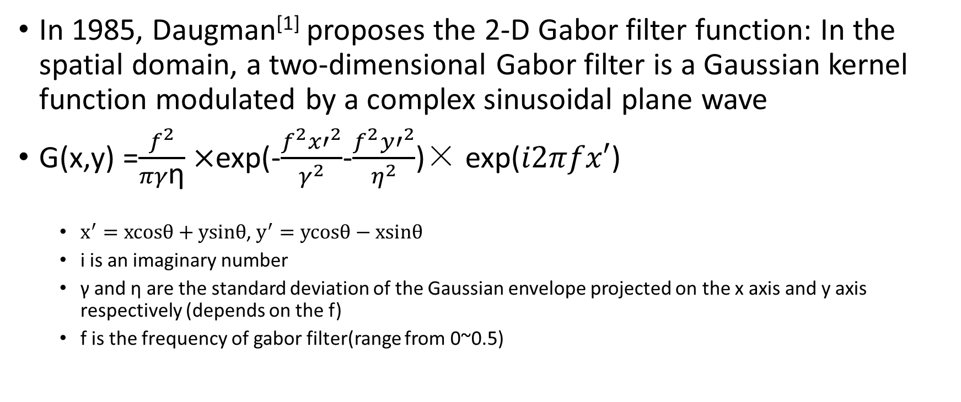
Feature Extraction
In 1985, Daugman^{[1]} proposes the 2-D Gabor filter function: In the spatial domain, a two-dimensional Gabor filter is a Gaussian kernel function modulated by a complex sinusoidal plane wave
G(x,y) =$\frac{f^{2}}{πγ\text{η}}×$exp(-$\frac{f^{2}{x′}^{2}}{γ^{2}}$-$\frac{f^{2}{y′}^{2}}{η^{2}}$)× exp($i2πfx′$)
$x^{′}=xcosθ+ysinθ$, $y^{′}=ycosθ−xsinθ$
i is an imaginary number
γ and η are the standard deviation of the Gaussian envelope projected on the x axis and y axis respectively (depends on the f)
f is the frequency of gabor filter(range from 0~0.5)

Slide 7
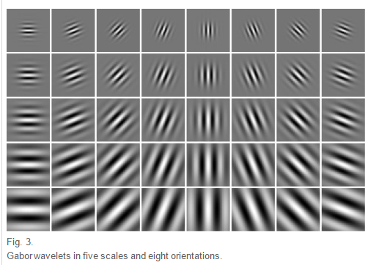
Feature Extraction
Use 5 scales and 8 orientation gabor filter set^{[2]}, each filter set is a 12*12 matrix
So each pixel in a image has 40 dimension features after filtering by gabor filter
Gabor wavelets in five scales and eight orientations^{[3]}

Slide 8
Data Reduction
If the image size is 100*100, its feature vector has 400000 dimensions, it’s too huge!
How to do?
(1)Downsample the feature: Based on the fact that adjacent pixels in the image are usually correlated^{[1]}, if we down sample the factor of two, the dimension of feature vector will be 400000/(2×2)=100000
(2)PCA: implementing followed the procedures from the course slide 6, p28

Slide 9
Classifier Selection
SVM: SVM has better performance to handle pattern recognition problem with small samples and nonlinear features.
I use the LIBSVM library to implement SVM classifier as what we did in the assignment 2, problem 4&5

Slide 10
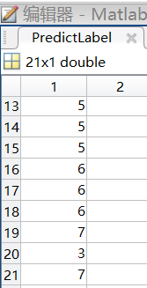
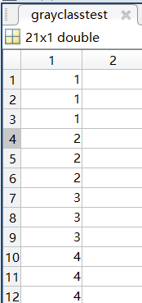
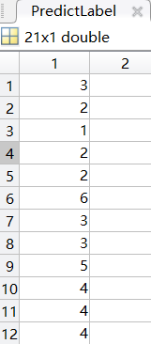
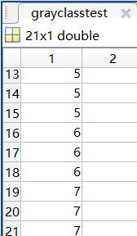
Test Result
Original label
Predict label
Original label
Predict label
The accuracy rate is 76.2% (16/21)

Slide 11
Summary
The Project is consist of 3 major parts: gabor feature + pca + svm
Future work:
(1)Use large facial expression database or random data(download images randomly from Internet) to run test
(2)Figure out how to find appropriate value of variables in gabor feature method so that it has the best performance. For example, how to define the maximum frequency of gabor filter sets

Slide 12
Reference
[1] JG Daugman. Complete discrete 2-D Gabor transforms by neural networks for image analysis and compression, IEEE Transactions on Acoustics Speech & Signal Processing, 1988, 36(7):1169-1179
[2] TS Lee. Image representation using 2D Gabor wavelets. Pattern Analysis & Machine Intelligence IEEE Transactions. 1996, 18(10):959-971
[3] M Haghighat, S Zonouz, M Abdel-Mottaleb. CloudID: Trustworthy cloud-based and cross-enterprise biometric identification. Expert Systems with Applications, 2015, 42(21):7905-7916

Slide 13
Reference
[4] V Kyrki, JK Kamarainen, H KälviäinenSimple. Gabor feature space for invariant object recognition. Pattern Recognition Letters, 2004, 25(3):311-318
[5] L Chengjun, W Harry. Gabor feature based classification using the enhanced fisher linear discriminant model for face recognition. IEEE Transactions on Image Processing A Publication of the IEEE Signal Processing Society, 2002, 11(4):467-476

